Slide 1


DentTime
Data Pipeline for dental ML
ระบบเตรียมข้อมูลสำหรับโมเดลทำนายเวลาหัตถการ
1. Anonymization
2. Airflow Pipeline
3. Handoff
HMAC + k-anonymity
4 tasks, monthly
clean dataset + docs
→ PDPA safe
→ auto, retryable
→ 252K rows ready

Slide 2



The Pipeline
1.
2.
3.
4.
INGEST
VALIDATE
ANONYMIZE
PUBLISH
pick up CSVs
check schema
hash + drop PII
send to next team
fail-fast !
k-anon k=5
+ manifest
STOP!
don't send bad data
on retry: each task tries 2x before giving up.
idempotent — safe to re-run the same month.
logs: row counts, duration, status — every run.

Slide 3



Where the data goes
Start with 424K raw rows. Keep 252K clean ones.
raw CSV
3 files from DentCloud
424,053 rows
100%
the big drop:
dedupe removes
~163K duplicate
after dedupe
appointment_id duplicated
261,407 rows
appointment rows.
61.6%
merging 3 source
CSVs caused overlap.
after k-anon k=5
drop tiny QI groups
252,359 rows
59.5%
k-anon dropped only ~3.5% — most rows survive.

Slide 4







Why file-drop (not DB)?
(source)
WHY?
safer.
CSV export
decoupled.
backfill =
Airflow
drop a file.
incoming/
published/
pipeline
clean
*.csv
dataset
(monthly)
no DB credentials in the pipeline = nothing to break in production.

Slide 5




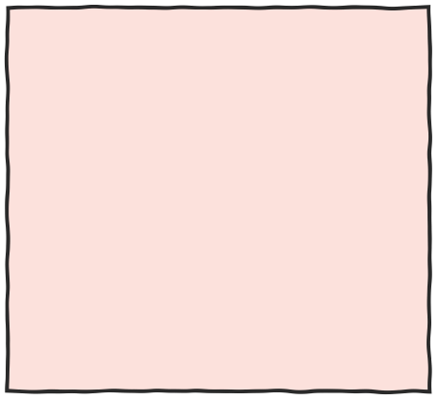
What downstream gets
1 dataset · 252,359 rows · 21 columns in 5 groups
1. IDs
2. Clinical
3. Time
4. Behavioral
5. Appt. Order
clinic
dentist
appointment
has_dentist_id
treatment
tooth_no
surfaces,
total_amount,
has_notes
year_month,
day_of_week,
hour_bucket
duration,
delays,
offsets,
status flags
appointment_
rank_in_day,
is_first_case
→ target:
scheduled_duration_min
→ split by:
appt_year_month
(time-based)

Slide 6


Things to know
tradeoffs & limits — before you use this dataset
IDs rotate every run
can't join across dataset versions
notes are gone
only has_notes flag (0/1) kept — PDPA
hour is fuzzy
4-hour bucket, not exact time (k-anon cost)
~50% rows missing dentist license
kept with has_dentist_id flag — FE uses Two-Tier Fallback

